Slide 1



Turning Hosts into SUPER hosts
Group18 Consulting Co.
Project Marvel
Phase 1 Milestone Update
G18 Consulting Project Team:
Jonathan YORK Anthony WONG
Jisoo KIM Elsa ZHAN
Daoqing SU Terence ZHANG

Slide 2
1.
Introduction
Definition of the project
Background of the Airbnb’s ‘Superhost’ programme
Hong Kong Market Study

Slide 3

1.1 Project Definition
What are some simple and actionable factors that can help hosts in Hong Kong become ‘Superhosts’?
Quantitative analyses on the influential factors that help hosts in Hong Kong to become “Superhosts”

Slide 4
1.2 Background - “Superhost”
What is a ‘Superhost’?
Why ‘Superhost’?
What’s in it for Airbnb?
Airbnb’s top performing hosts.
The host must own an account in good standing who has met the following criteria in the past 12 months:
Completed at least 10 trips or 3 reservations that total at least 100 nights;
Maintained a 90% + response rate;
Maintained a less than 1% cancellation rate, with exceptions made for those that fall under Airbnb’s extenuating circumstances policy;
Maintained a 4.8 overall rating.
More visibility from prospective guests, additional earning potentials, exclusive rewards and getting priority support from Airbnb
5% increase in weekly views
81% higher occupancy rate
Earn 60% more daily revenue than regular hosts on average
Cash rewards from AirBnB for mentorship
Given that Airbnb revenue comes from two major sources, it is also incentivised to encourage more hosts to become “Superhosts”:
Commission from hosts: Everytime someone chooses a host’s property and makes payment, Airbnb takes 10% of the payment amount as commission.
Transaction fee from travelers: When travelers make payments for stays, they are charged a 3% fee for the transaction. This amount adds to the Airbnb revenue.

Slide 5


1.2 Background - Market Study
19.4%
10.5%

Slide 6
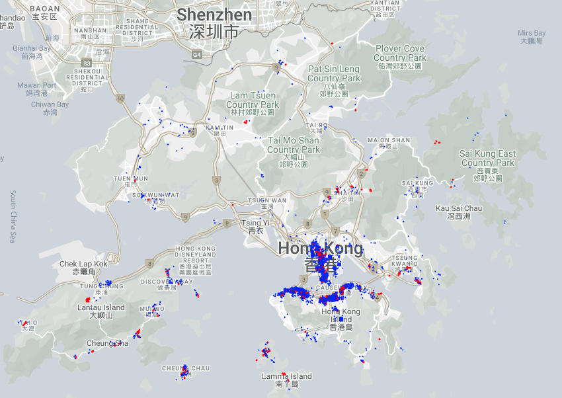
1.2 Background - Hong Kong Market Study
Neighbourhood Impact?
Listings in Shatin, Sai Kung and the Hong Kong Island are typically listed by “Superhosts”.
Listings in Kwai Tsing, Wong Tai Sin and Sham Shui Po have the lowest rate of “Superhosts”.
5056 listings, 532 superhosts
Data last scraped in 16 Sept 2022
Includes hosts from 2009 to 2022

Slide 7
1.3 Stakeholder Analysis
Providing practical tips to assist aspiring hosts and existing hosts becoming “Superhosts”.
Stakeholders to be influenced
AirBnb
Stakeholders with influence
Aspiring hosts
Existing & potential guests of Airbnb
Existing hosts

Slide 8
2.
Analysis & Findings
Data Cleaning and Preparation
Models and findings

Slide 9
2.1 Data Preparation
Dataset:
5056 listings in HK, 75 columns
Overview on variables:
- Information on host : location, id, verification status
- Information on listing : max/min nights available, price, amenities, room type, location
- Information on review scores : breakdown of review scores and its values
Steps taken for Data Preparation:
converting data with ‘object’ data type to appropriate data types;
dropping columns that have more than 75% missing values;
filling missing data with appropriate entries;
dropping variables; and
creating categorical/dummy variables.

Slide 10
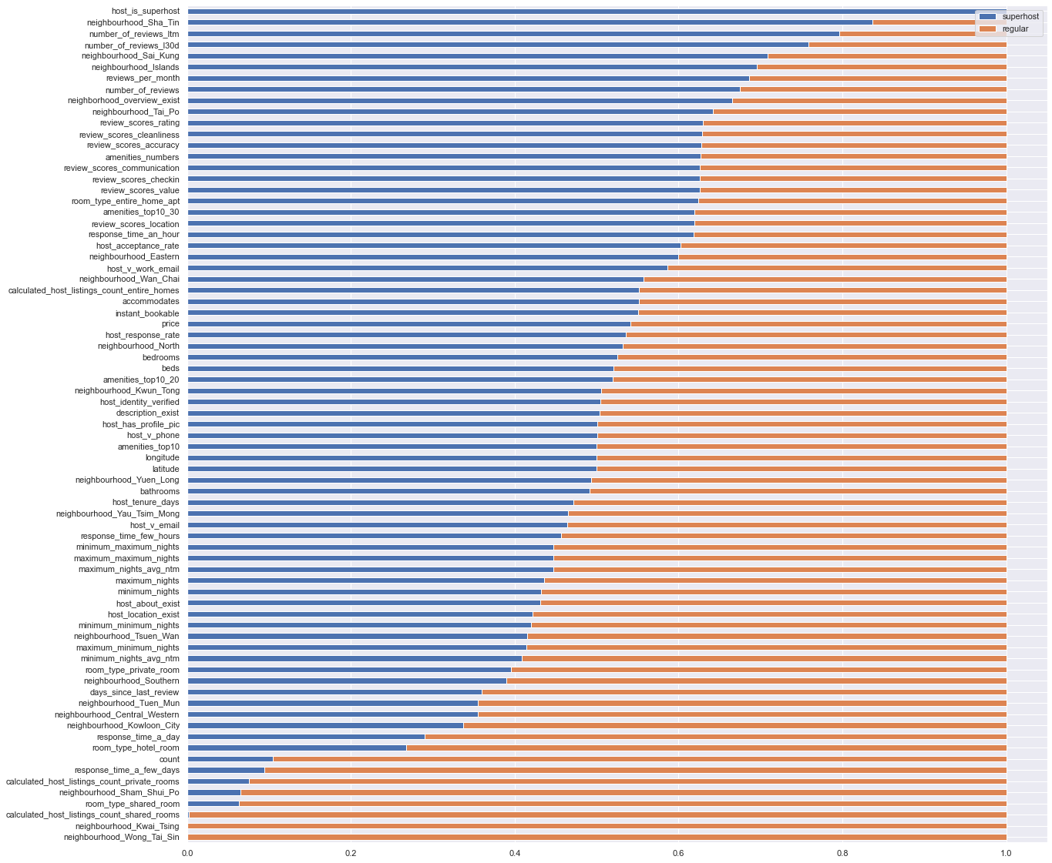
2.2 Understanding Host vs. Superhost
Understanding the differences
Neighbourhood matters!
Reviews and Superhosts are correlated
Number of reviews also matter to becoming Superhosts
…
There is a lot…
TLDR: There are many factors which correlate to becoming a Superhost, however, not all of them are actionable nor simple.

Slide 11
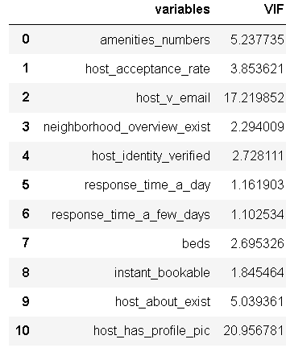
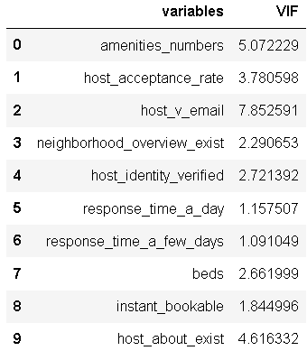
2.2 Models and Results
Model 1 : Logistic Regression on Feature Data
Host_is_Superhost : Dependant Variable (Binary)
Used AIC forward Selection model to further narrow down the number of variables.
Conducted VIF analysis to check for multicollinearity issue. Where we decided to drop ‘host_has_profilepic’
Our final logistic regression model contains 9 variables.

Slide 12
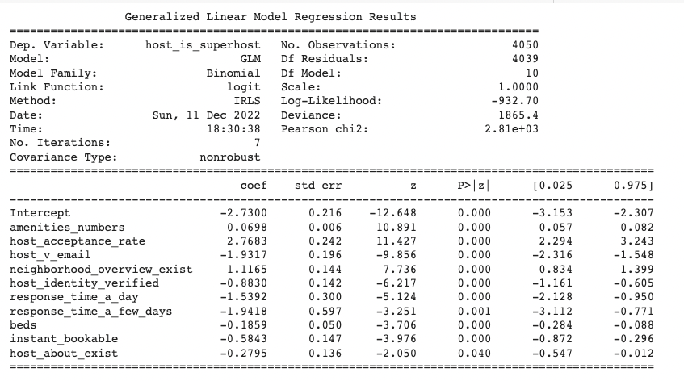

Slide 15
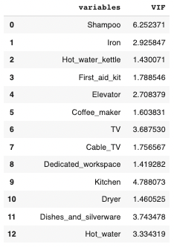
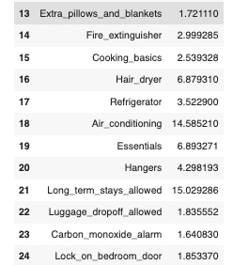
2.2 Models and Results
Model 2: Logistic Regression on Amenity Data
Taking one step further in looking at the ‘Amenities’.
Filtered out most generally available in listings in Hong Kong. Picked 35 variables, which accounts for over 80% of the amenities listed in HK.
Conducted another logistic regression to look at the ones that are most relevant to ‘Superhost’ status?
Used AIC forward Selection Model and VIF to test for Multicollinearity issues.

Slide 16
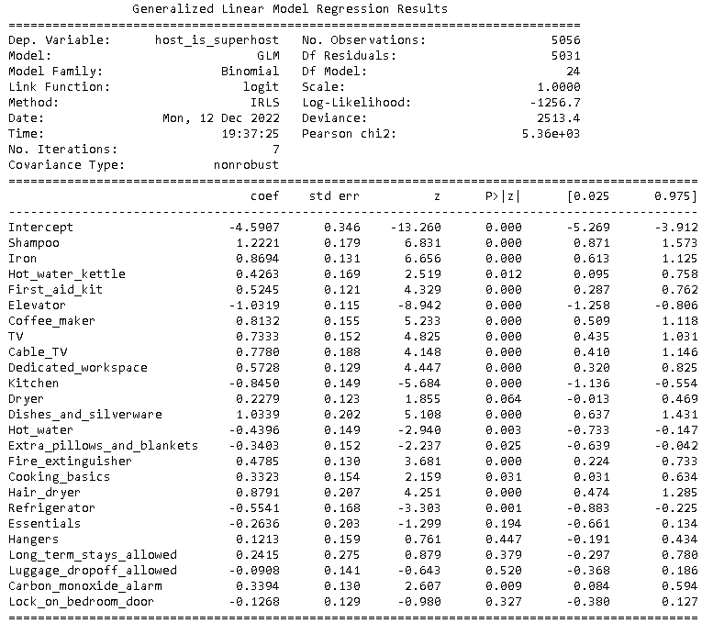
Top 3: Shampoo
Iron Coffee maker

Slide 17
Negative Impact : Why?
Kitchen Elevator

Slide 18
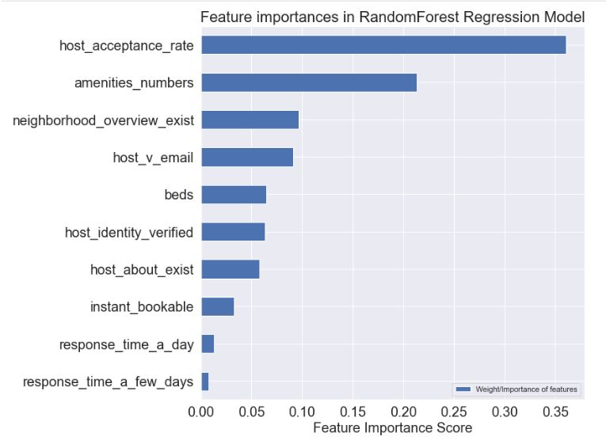
2.2 Models and Results
Random Forest Regression on the variables identified for the final Model 1 above to verify the importance of each variable from another perspective.
Both models produce similar results in that the number of available amenities and the hosts’ acceptance rate as well as the existence of neighbourhood overview have the highest impact on becoming “Superhosts”.
Model 3 : Random Forest Classification on Feature Data

Slide 19
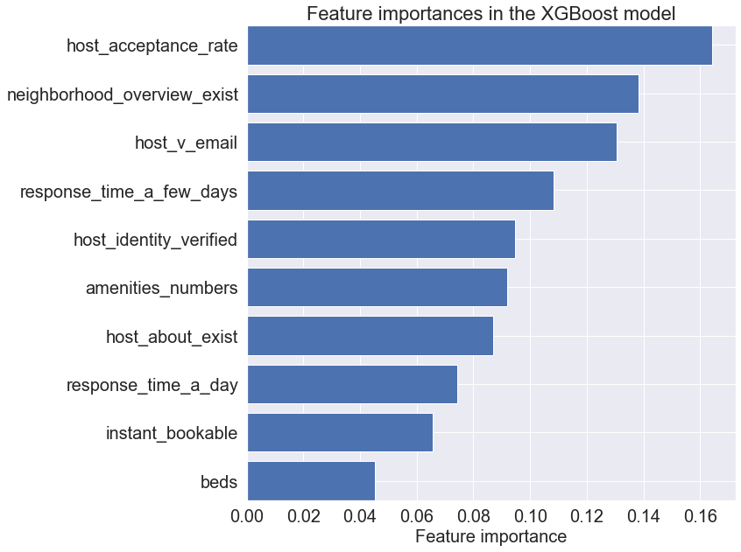
2.2 Models and Results
XGBoost model to verify the importance of each variable identified in the final Model 1
Hosts having verification emails and slow response time have the highest importance score.
we must be cautious that this model does not tell whether a feature positively or negatively impact the prospective of becoming “Superhosts”.
Model 4: XGBoost

Slide 20
3.
Recommendations
Recommendations for hosts

Slide 21




3. Recommendations
Airbnb should encourage Hong Kong hosts to …
Respond to clients within a day
Accept bookings as much as possible Remove listing for future dates in advance if they cannot accept booking
Include overview of the neighborhood in the listing
Provide more amenities. Not just the staples but extra touches for your guests
Top amenities:
Iron, TV, equipped kitchen, equipped bathroom, workspace, safety equipment

Slide 22


Thanks!
Any questions?
You can find us at
ProjectMarvel@G18Consulting.co

Slide 23
4.
Appendix
Data Cleaning Process
Classification in respect of Logistic Regression
Model Evaluation Metrics

Slide 24
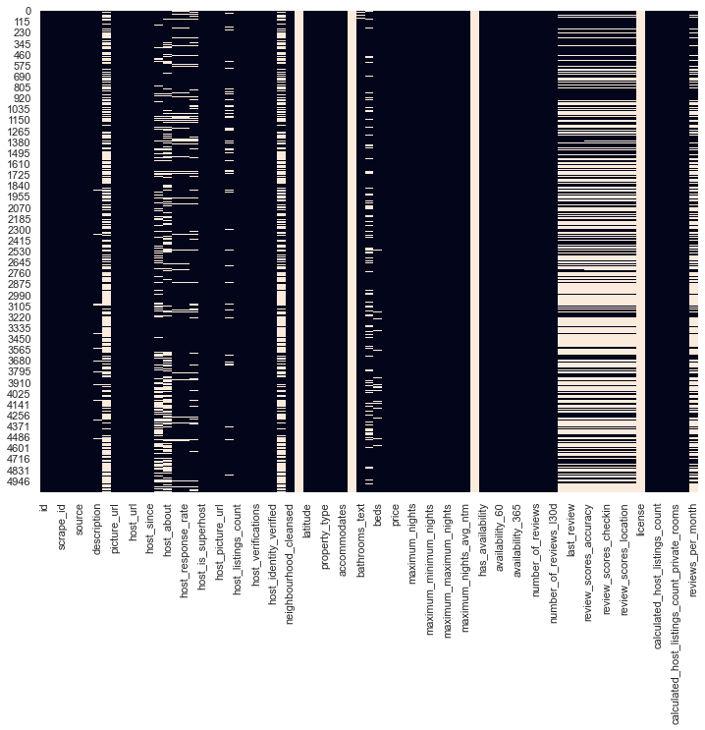
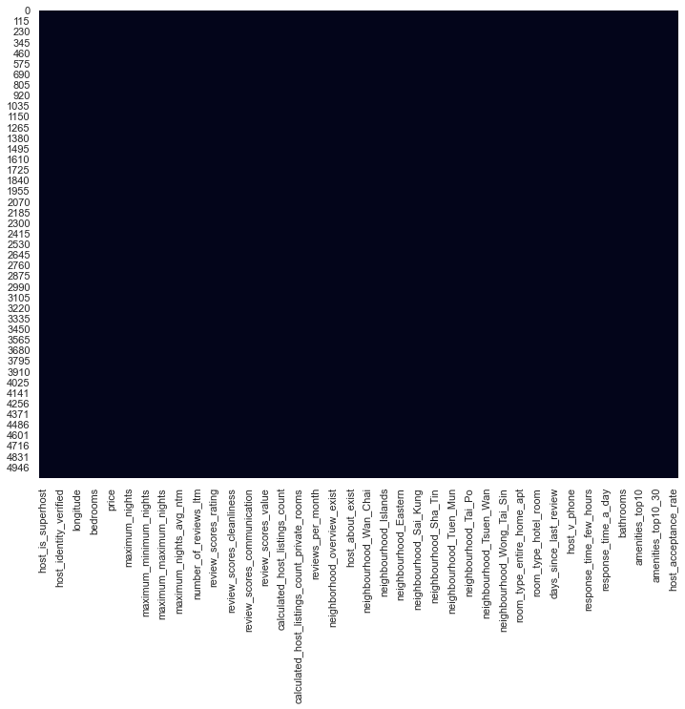
Shows the plot of missing data before and after clean up.

Slide 25
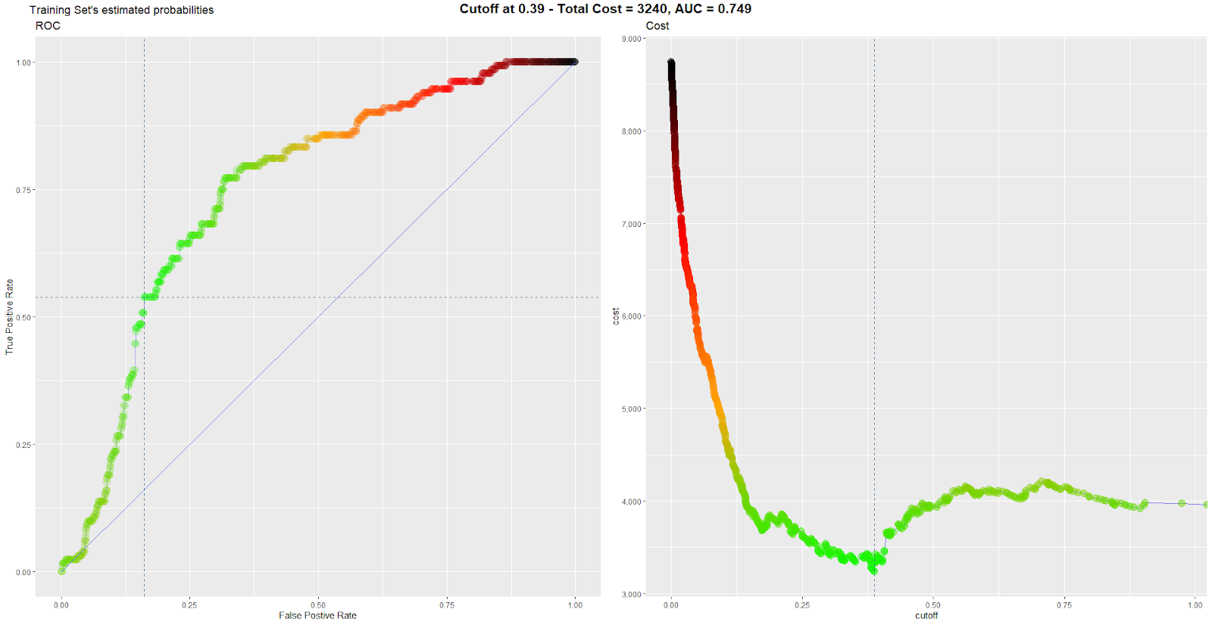
Based on the 5-folded cross-validation approach together with an assumption that the cost of wrongly predicting the hosts to become a Superhost (false negative) is triple the cost of not predicting some Superhost in advance (false positive), we determine the optimal cut-off point to be 0.39, which could minimise the total cost. That will lead to an AUC of 0.749.

Slide 26
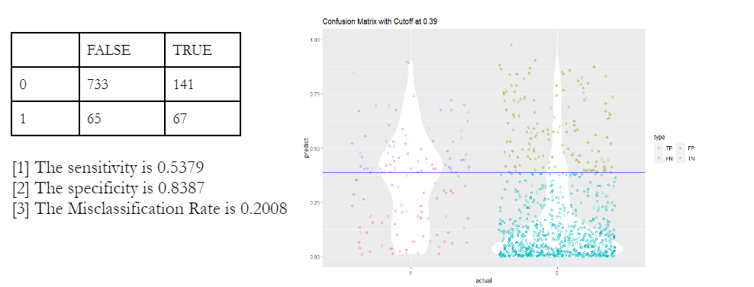
It could be concluded that the model gives reasonable prediction accuracy with the TP rate (Sensitivity) of 53.79%, whereas the overall Misclassification Rate is 20.08%.

Slide 27
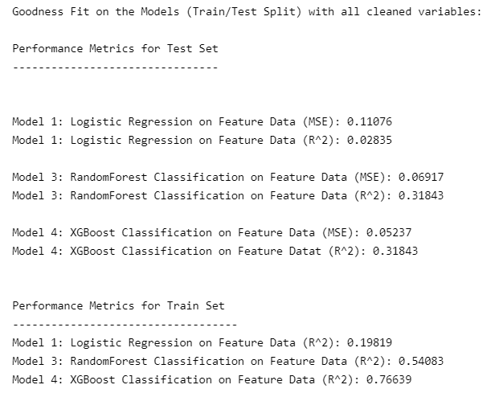
Using MSE and R^2, we have evaluated each models we used in this report.
XGBoost Classification shows the highest R^2, and the lowest MSE.

Slide 28




Initial observations
Amenities
Number of total amenities, number of top 10 amenities as well as listing the entire home appear to be some of the contributing factors.
Where the listings are…
Reviews
The more reviews the hosts received, the better the chance of such hosts becoming “Superhosts”.
Neighbourhood
Better neighbourhood environments may result in a better chance of achieving the “Superhost” status
Prices
The average price for listings made by “Superhosts” is only marginally higher than those made by regular hosts.

